Slide 1





JAI SHREE GANESH
WELCOME TO WORLD OF ANALYTICS

Slide 2
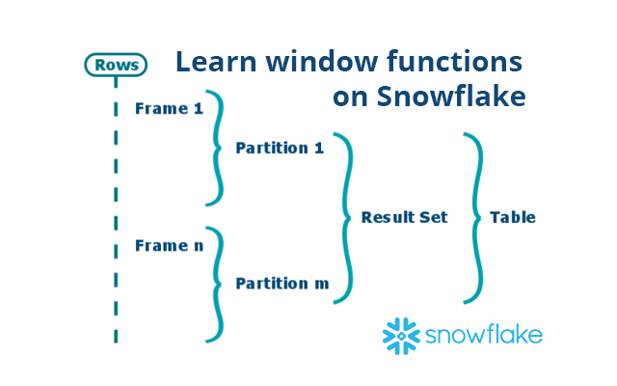
Window Functions
Window functions in Snowflake are a way to compute values over a group of rows.
They return a single value for each row, in contrast to aggregate functions which return a single value for a group of rows.
Window functions are the base of data warehousing workloads for many reasons.
First of all they are very similar to the GROUP BY clause as they run on a set of rows instead of a single one but, but unlike the GROUP BY clause we do not lose the individual rows.
To remedy this we could perform a self join with the result of GROUP BY operation but window functions implement the same functionality in a more efficient way that gives better performance.
Window functions also provide complex functions that are based on the (requested) order of rows such as DENSE_RANK which would be hard to implement with traditional SQL.
Using window functions you can avoid writing procedural SQL code.

Slide 3
OVERVIEW
What is a Window?
A window is a group of related rows.
For example, a window might be defined based on timestamps, with all rows in the same month grouped in the same window.
Or a window might be defined based on location, with all rows from a particular city grouped in the same window.
A window can consist of zero, one, or multiple rows.
For simplicity, Snowflake documentation usually says that a window contains multiple rows.

Slide 4
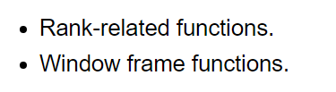
OVERVIEW
Some window functions are order-sensitive. There are two main types of order-sensitive window functions:
Rank-related functions list information based on the “rank” of a row.
For example, if you rank stores in descending order by profit per year, the store with the most profit will be ranked 1; the second-most profitable store will be ranked 2, etc.
Window frame functions allow you to perform rolling operations, such as calculating a running total or a moving average, on a subset of the rows in the window.

Slide 5
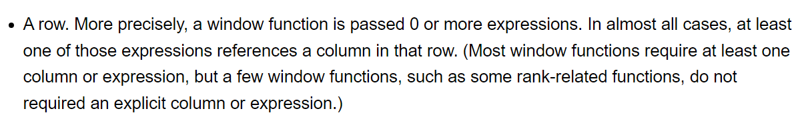
What is a Window Function?
A window function is any function that operates over a window of rows.
A window function is generally passed two parameters:

Slide 6
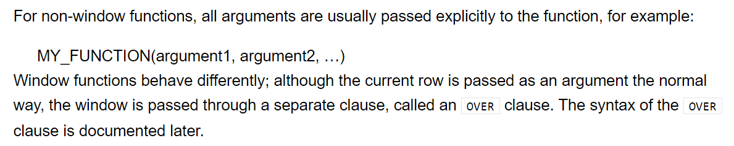
What is a Window Function?

Slide 7
Why use window functions?
Window functions are very powerful, and once you've gotten your head around how to use them, you'll be surprised at what they allow you to do.
Some common use cases are:
Running/Cumulative Total
Moving Average
Rank rows by custom criteria and groupings
Finding the year-over-year % Change

Slide 8

SYNTAX
where the PARTITION BY denotes how to GROUP rows into partitions, ORDER BY how to order the rows in those partitions, and FRAME which determines which rows to consider in those ordered partitions.
Each time a window function is called, it is passed a row (the current row in the window) and the window of rows that contain the current row.
The window function returns one output row for each input row.
The output depends on the individual row passed to the function and the values of the other rows in the window passed to the function.

Slide 9
TYPES
In general, window functions can be grouped into 3 types:
Navigation functions: Return the value given a specific location criteria (e.g. first_value)
Numbering functions: Assign a number (e.g. rank) to each row based on their position in the specified window
Analytic functions: Perform a calculation on a set of values (e.g. sum)

Slide 10
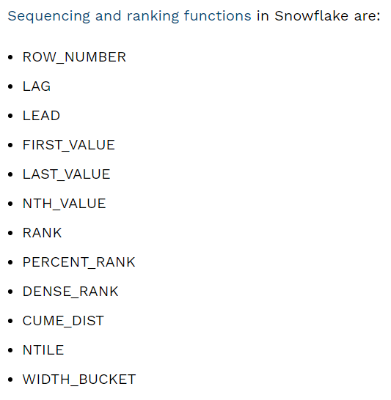
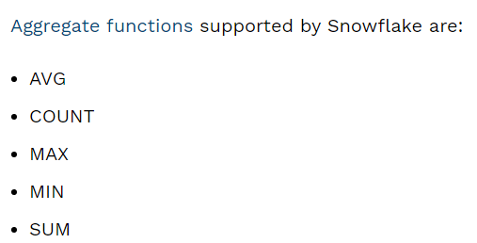
Aggregate and sequencing functions on Snowflake
Aggregate functions perform operations that take into account all values across a window. Sequencing functions produce output based on the position of the row in the window.

Slide 11
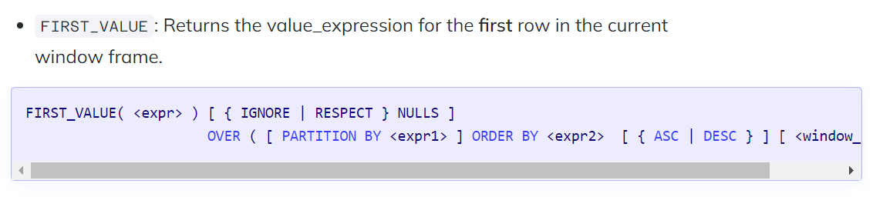
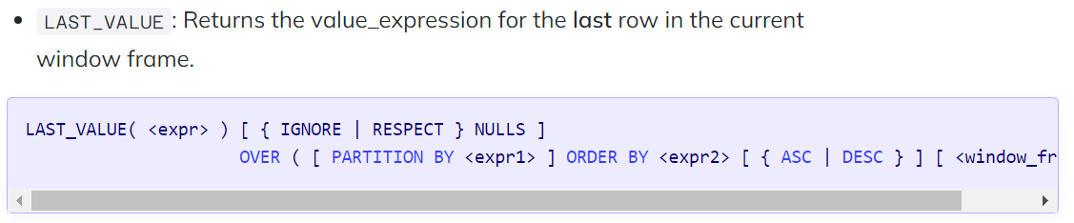
Navigation functions

Slide 12
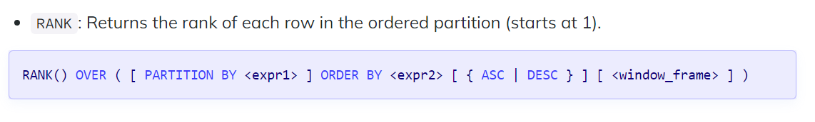
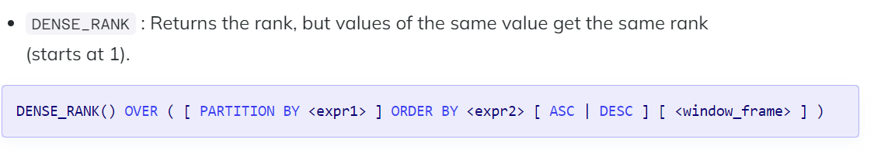
Numbering functions

Slide 13
ROW_NUMBER()
The ROW_NUMBER() is an analytic function that generates a non-persistent sequence of temporary values which are calculated dynamically when the query is executed.
The ROW_NUMBER() function assigns a unique incrementing number for each row within a partition of a result set.
The row number starts at 1 and continues up sequentially, to the end of the table.

Slide 14
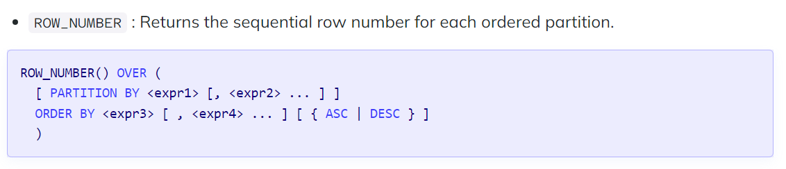
ROW_NUMBER() : SYNTAX

Slide 15
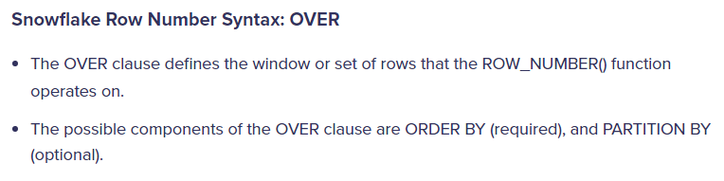
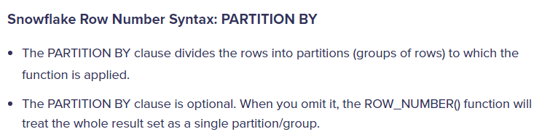
ROW_NUMBER() : SYNTAX

Slide 16
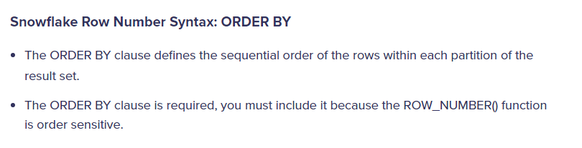
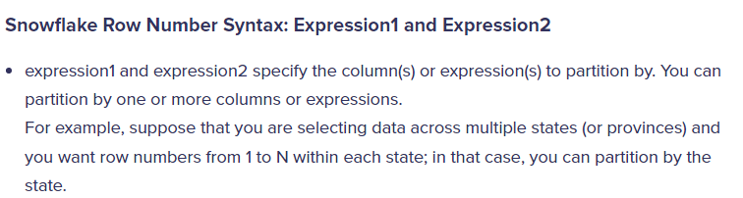
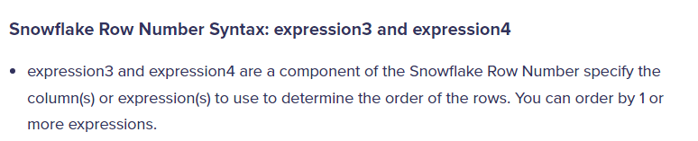
ROW_NUMBER() : SYNTAX

Slide 17
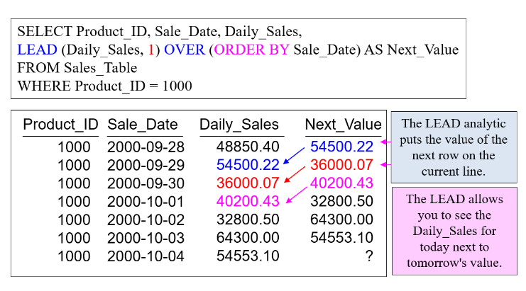
LEAD FUNCTIONS
Let me summarize the Lead in the picture below. Order the data first by the column Sale_Date and after the data sorts, then begin with row one and ask, “Can we get the Daily_Sales value from the next row, and add it to the current line?” If the answer is “Yes,” then do it, but if the answer is “No,” then put in a Null.

Slide 18
LEAD FUNCTIONS
The LEAD above allows you to see the Daily_Sales for today next to tomorrow’s value.
Check out the next picture below. Notice we have two leads, and one has a lead of one row, and the other has a lead of two rows. Now, row one has the Daily_Sales for today and the Daily_Sales for the next two days.
For the Next_Value column, the moving window is one. For the Two_Days column, the moving window is two. The moving window in Lead establishes by the numbers after LEAD (Daily_Sales, 1) or LEAD(Daily_Sales,2). You can put any number (n) in the moving window, and that tells Snowflake to get the value n rows down.

Slide 19
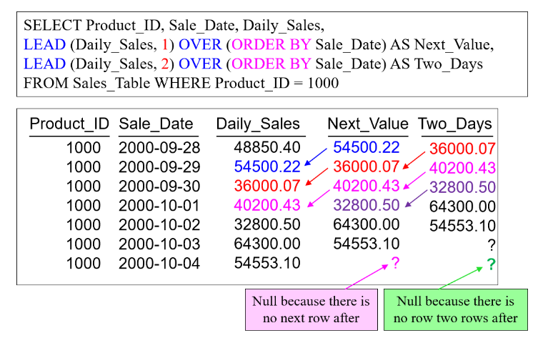
LEAD FUNCTIONS

Slide 20
LEAD FUNCTIONS
Now, we are going to take the next example even farther by adding a third day to the answer set, and we are also going to add the PARTITION BY statement and change our WHERE clause.
The PARTITION BY resets the calculation and acts much like a GROUP BY statement.
Notice that each Product_ID calculates within the Product_ID only. When a new Product_ID appears, the calculation starts over.

Slide 21
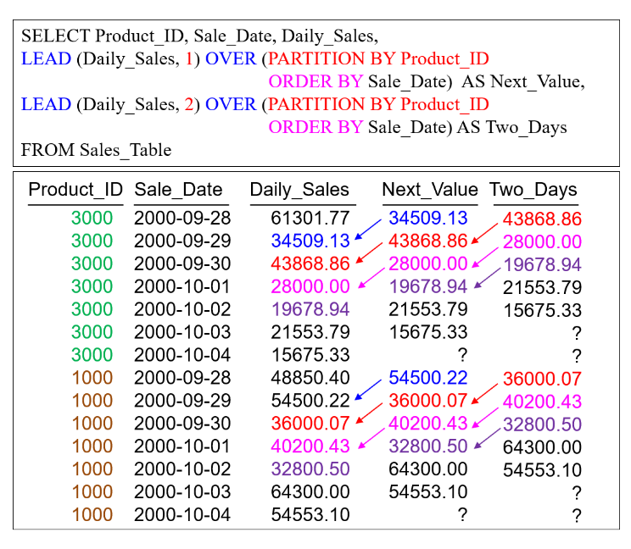
LEAD FUNCTIONS

Slide 22
LEAD FUNCTIONS
Now, we are going to take the next example even farther by adding a third day to the answer set and change our WHERE clause.
The PARTITION BY resets the calculation and acts much like a GROUP BY statement.
Notice that each Product_ID calculates within the Product_ID only.
When a new Product_ID appears, the calculation starts over.

Slide 23
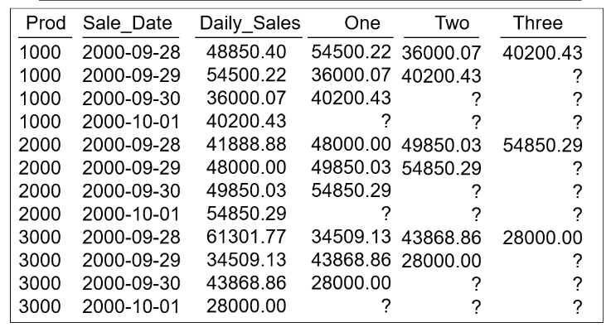
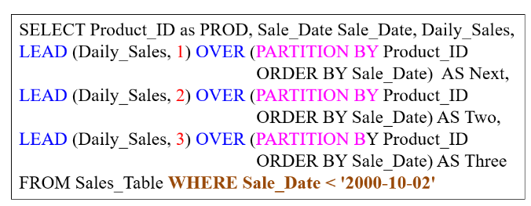
LEAD FUNCTIONS

Slide 24
LEAD FUNCTIONS
In the picture above, notice the null values.
They appear because there are no rows after available. We have run out of future row values to display. In another sense, we have all of the values needed on the first row of each Product_ID in the answer set. The first row in the answer set for each Product_ID gives us the full picture. Watch how clever this report gets when you add the QUALIFY statement. Compare the picture above with the picture below. Notice that the QUALIFY statement removes the additional rows not needed.

Slide 25
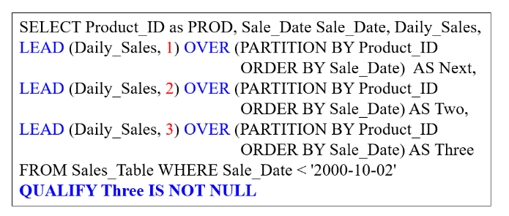
LEAD FUNCTIONS

Slide 26
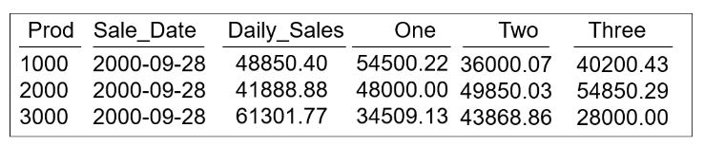
LEAD FUNCTIONS
The QUALIFY statement is to Ordered Analytics much like a HAVING statement is to aggregation.
QUALIFY is a filter that works on the calculations after they calculate.

Slide 27
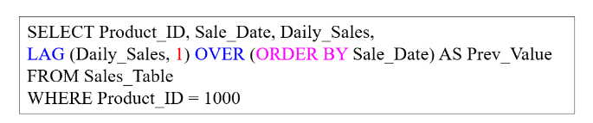
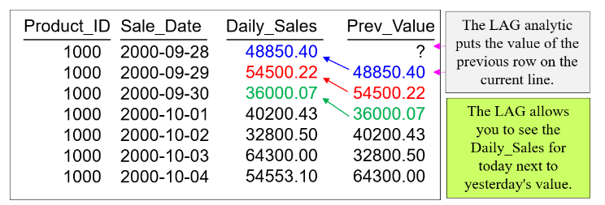
LAG FUNCTIONS

Slide 28
LAG FUNCTIONS
The LAG above allows you to see the Daily_Sales for today next to yesterday’s value.
Notice the example where it has LAG (Daily_Sales, 1).
The one represents the moving window.
We want to get the value of Daily_Sales one row up. I
f there were a two instead of a one, we would want to get the Daily_Sales value two rows above.
Sometimes you will see only LAG (Daily_Sales), which defaults to LAG (Daily_Sales, 1).

Slide 29
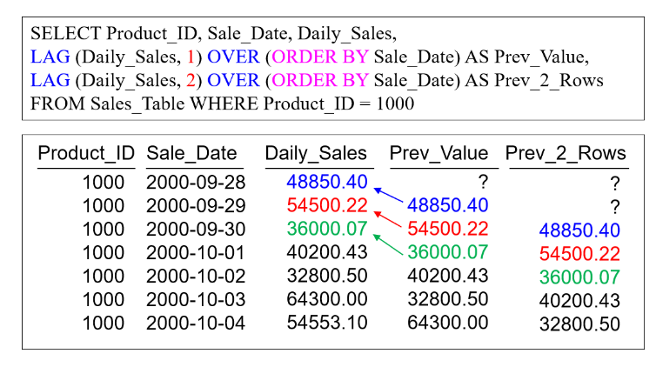
LAG FUNCTIONS
In the example below, we are using two LAG window functions. We alias the first LAG as Prev_Value because it is capturing the Daily_Sales value one row above. We give the second Lag an alias of Prev_2_Rows because it is capturing the value two rows above. On the current line of the answer set, we see today’s Daily_Sales, yesterday’s Daily_Sales, and the Daily_Sales from two-days previous.

Slide 30
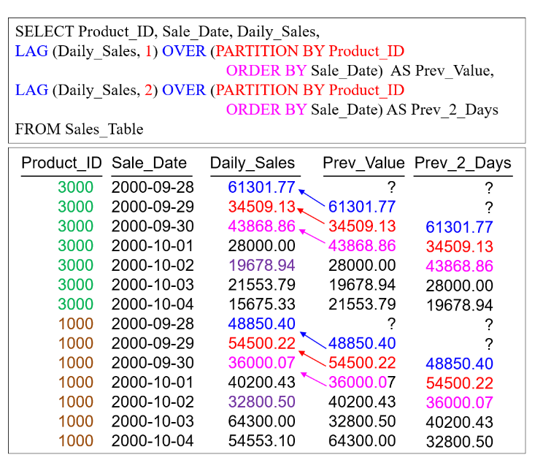
LAG FUNCTIONS
Now, we are going to take the next example even farther by adding a PARTITION BY statement. The PARTITION BY resets the calculation and acts much like a GROUP BY statement. Notice that each Product_ID calculates within the Product_ID only. When a new Product_ID appears, the LAG calculation starts over.

Slide 31
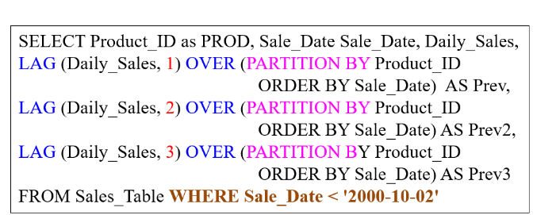
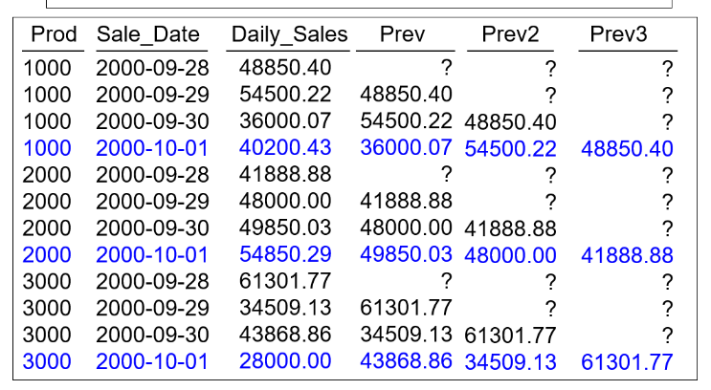
LAG FUNCTIONS
Now, in our next example, we will use PARTITION BY again, but we will have three lag statements with the last one to lag three rows back. I am doing this for a reason. I want to show you how to use the QUALIFY statement in the final example. In the picture below, notice the null values. They appear because there are no rows above available. We have run out of past values to display.

Slide 32
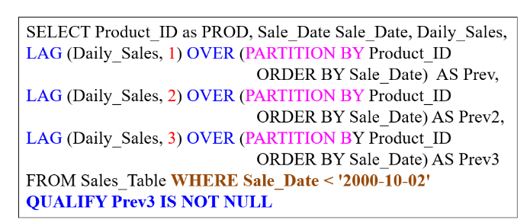
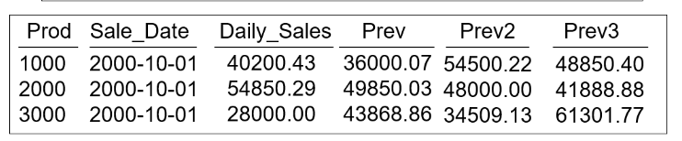
LAG FUNCTIONS
In the picture above, notice the null values. They appear because there are no rows above available. The last row in the answer set for each Product_ID gives us the full picture. Watch how clever this report gets when you add the QUALIFY statement. Compare the picture above with the picture below. Notice that the QUALIFY statement removes the additional rows not needed. Qualify is an additional filter that works on the analytic totals after they calculate.
The QUALIFY statement is to Ordered Analytics, much like a HAVING statement is to aggregation. Only Teradata and Snowflake have the QUALIFY statement available.

Slide 33


